Slide 1
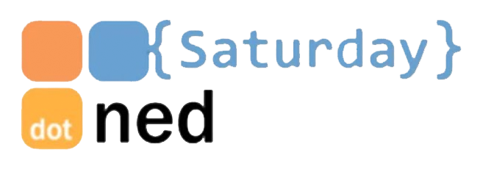



or ?
The 5 Durable Functions patterns explained!
Kees Schollaart
Technical Evangelist
Microsoft.

Slide 2
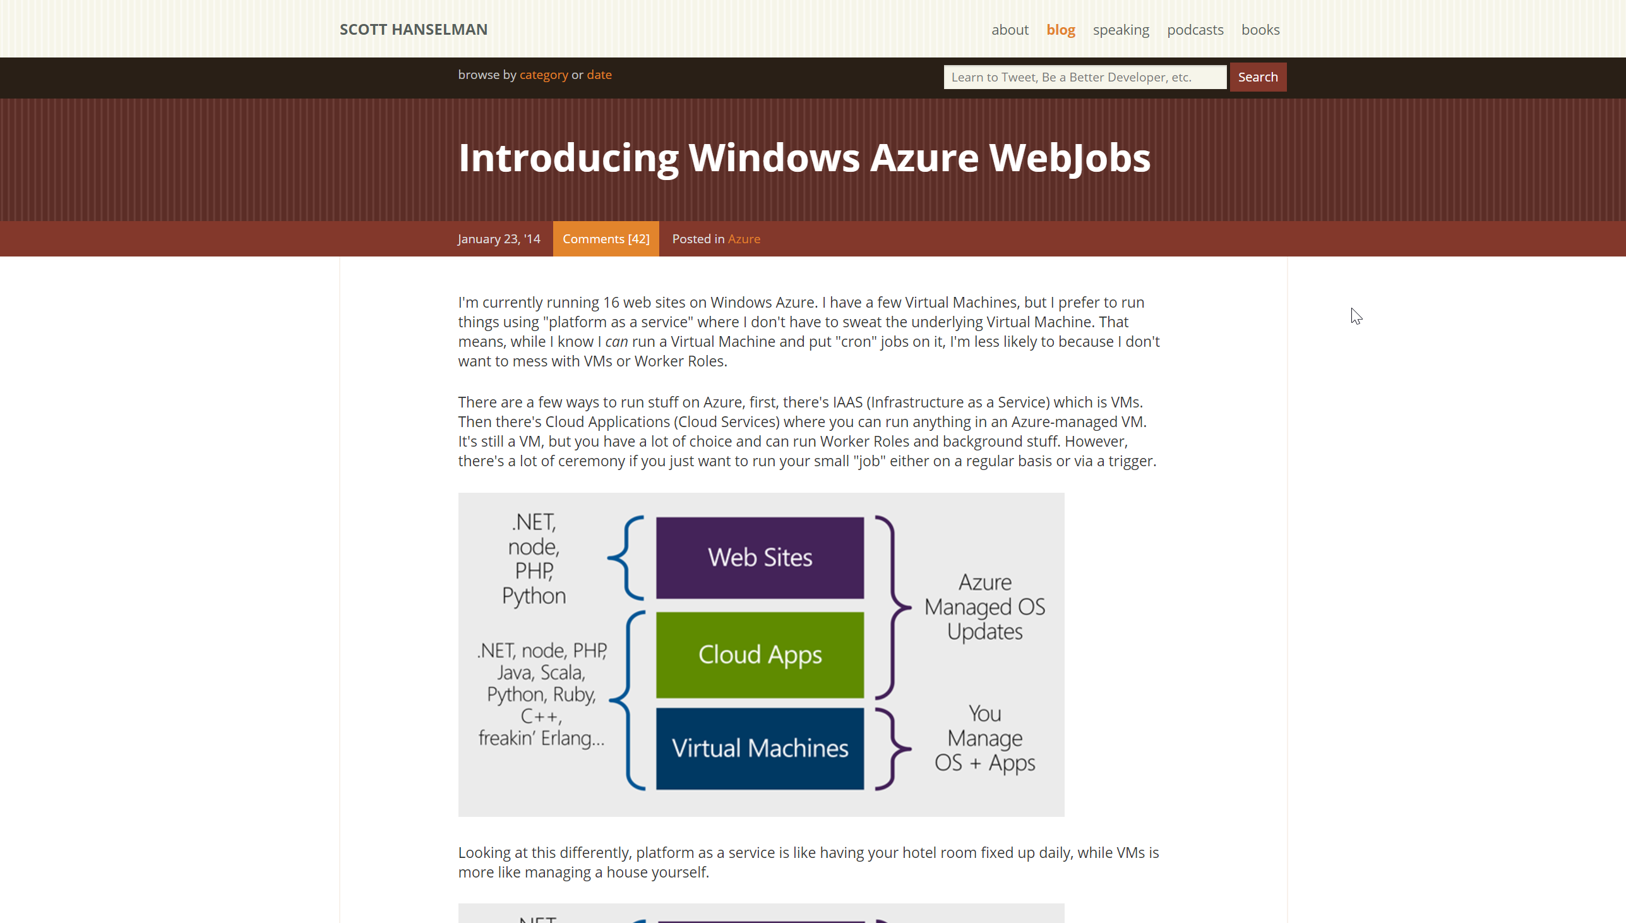
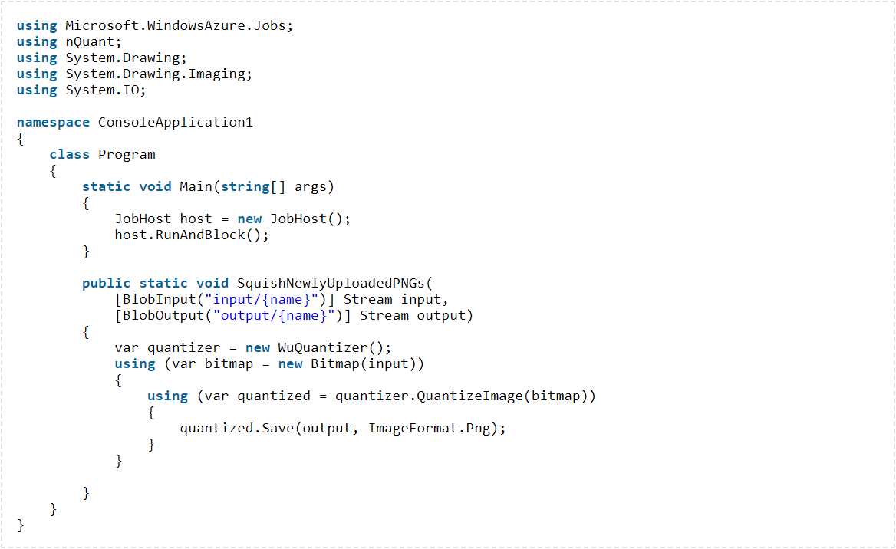
2014 > 2016 > 2017 > 2018
Notes:
The story…
Webjobs
Triggered / continuous
Attributes / bindings
Scalable
Coming from IIS/MSMQ/Services > Azure / Cloud Services

Slide 3
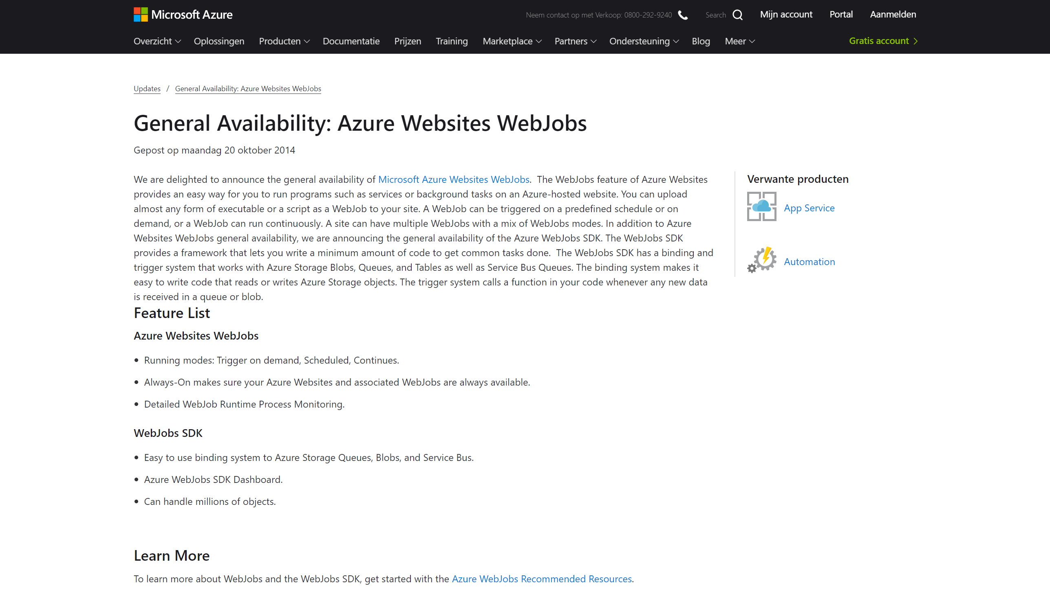
2014 > 2016 > 2017 > 2018

Slide 4
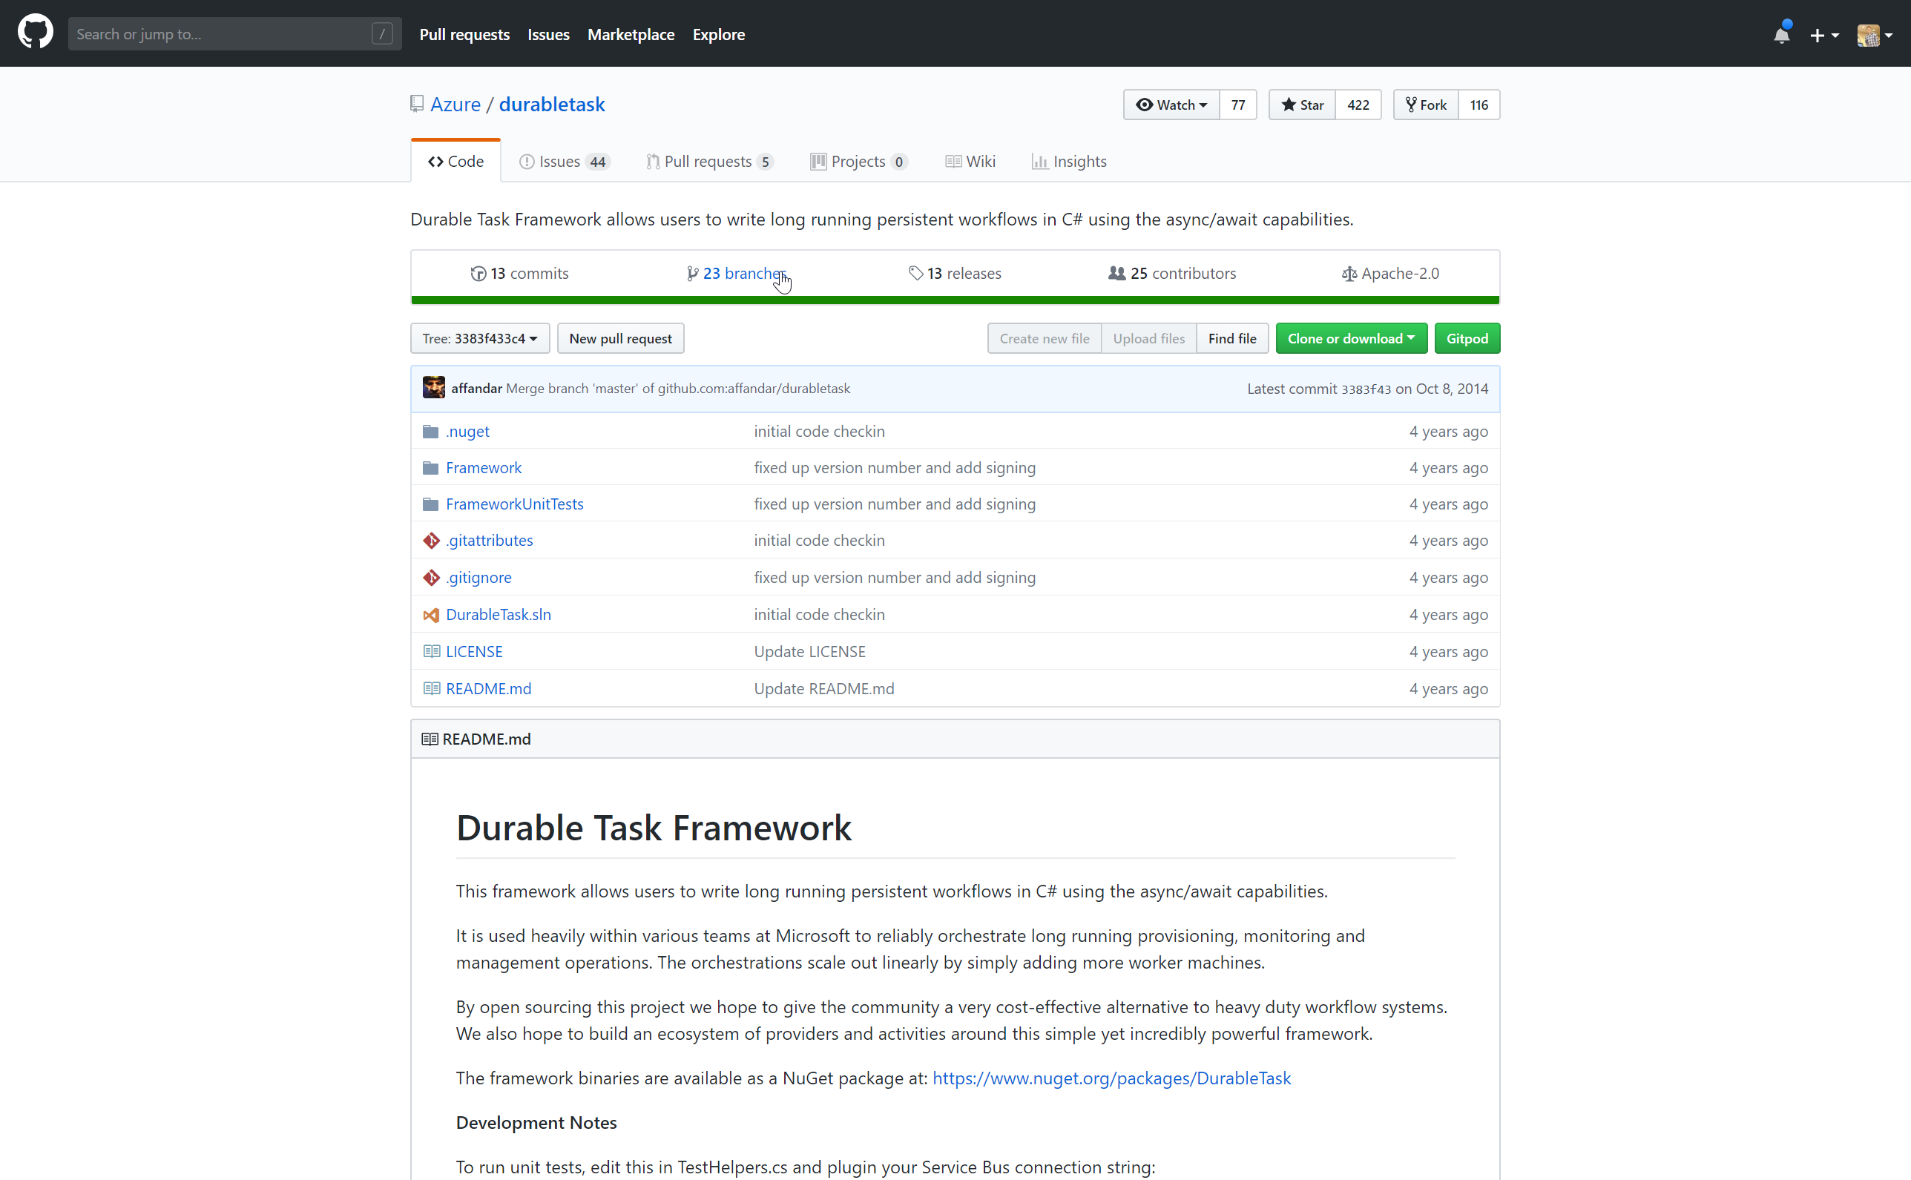
2014 > 2016 > 2017 > 2018

Slide 5
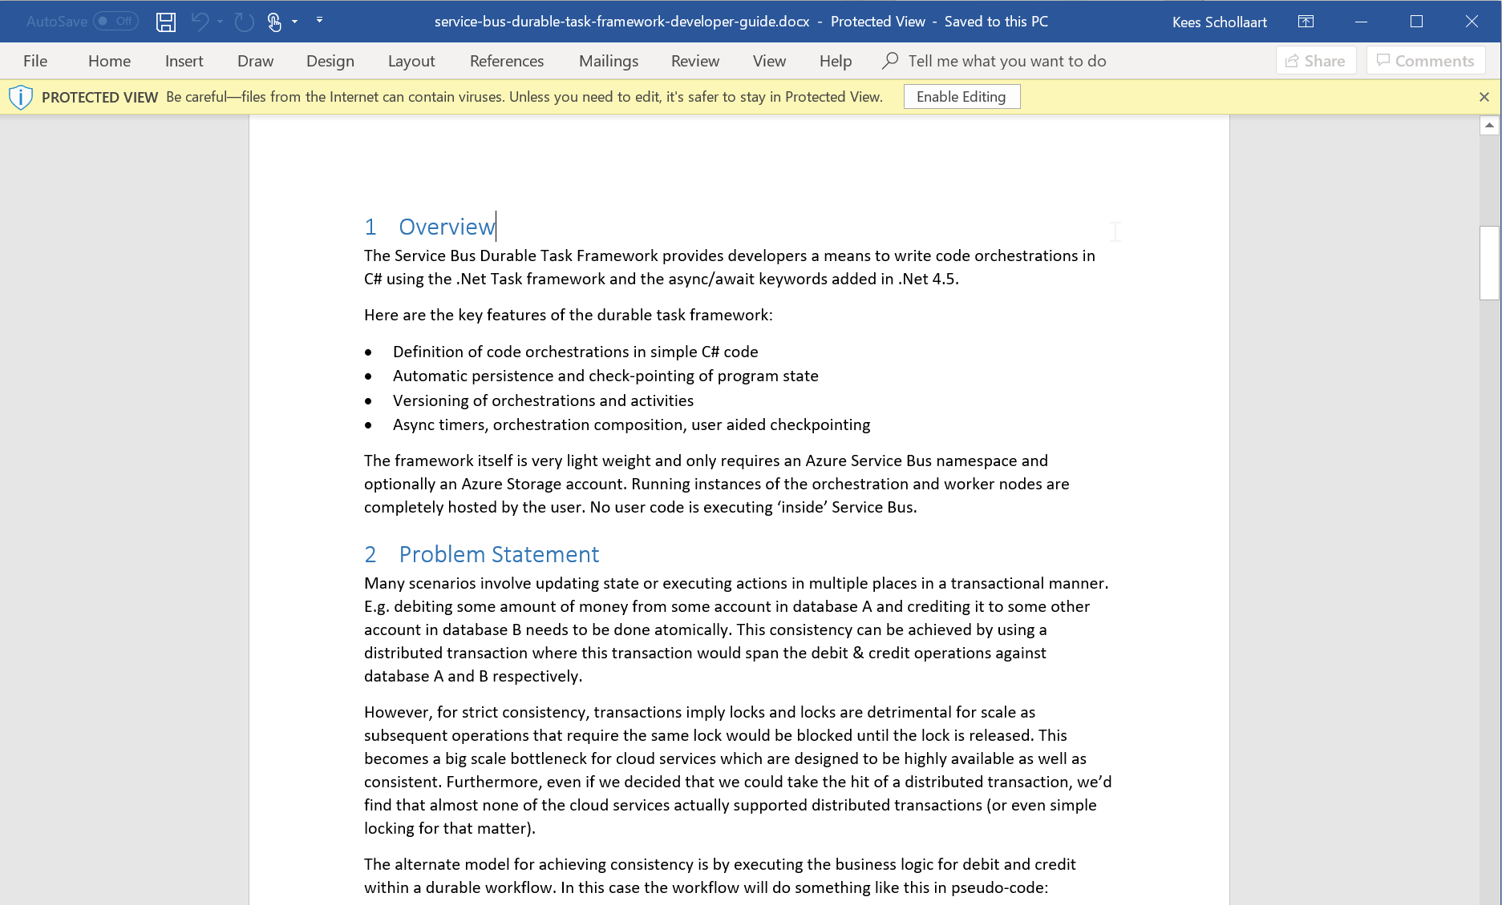
2014 > 2016 > 2017 > 2018
Notes:
Simple orch. in code
State checkpointing

Slide 6
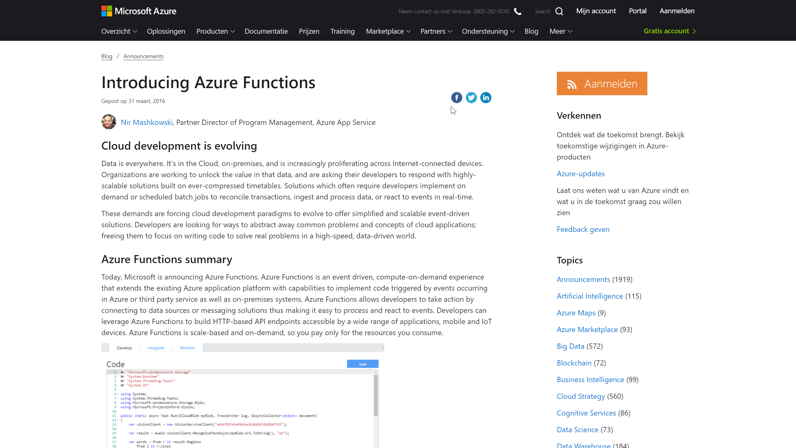
2014 > 2016 > 2017 > 2018
Notes:
Event Driven
On-demand compute
Consumption model

Slide 7
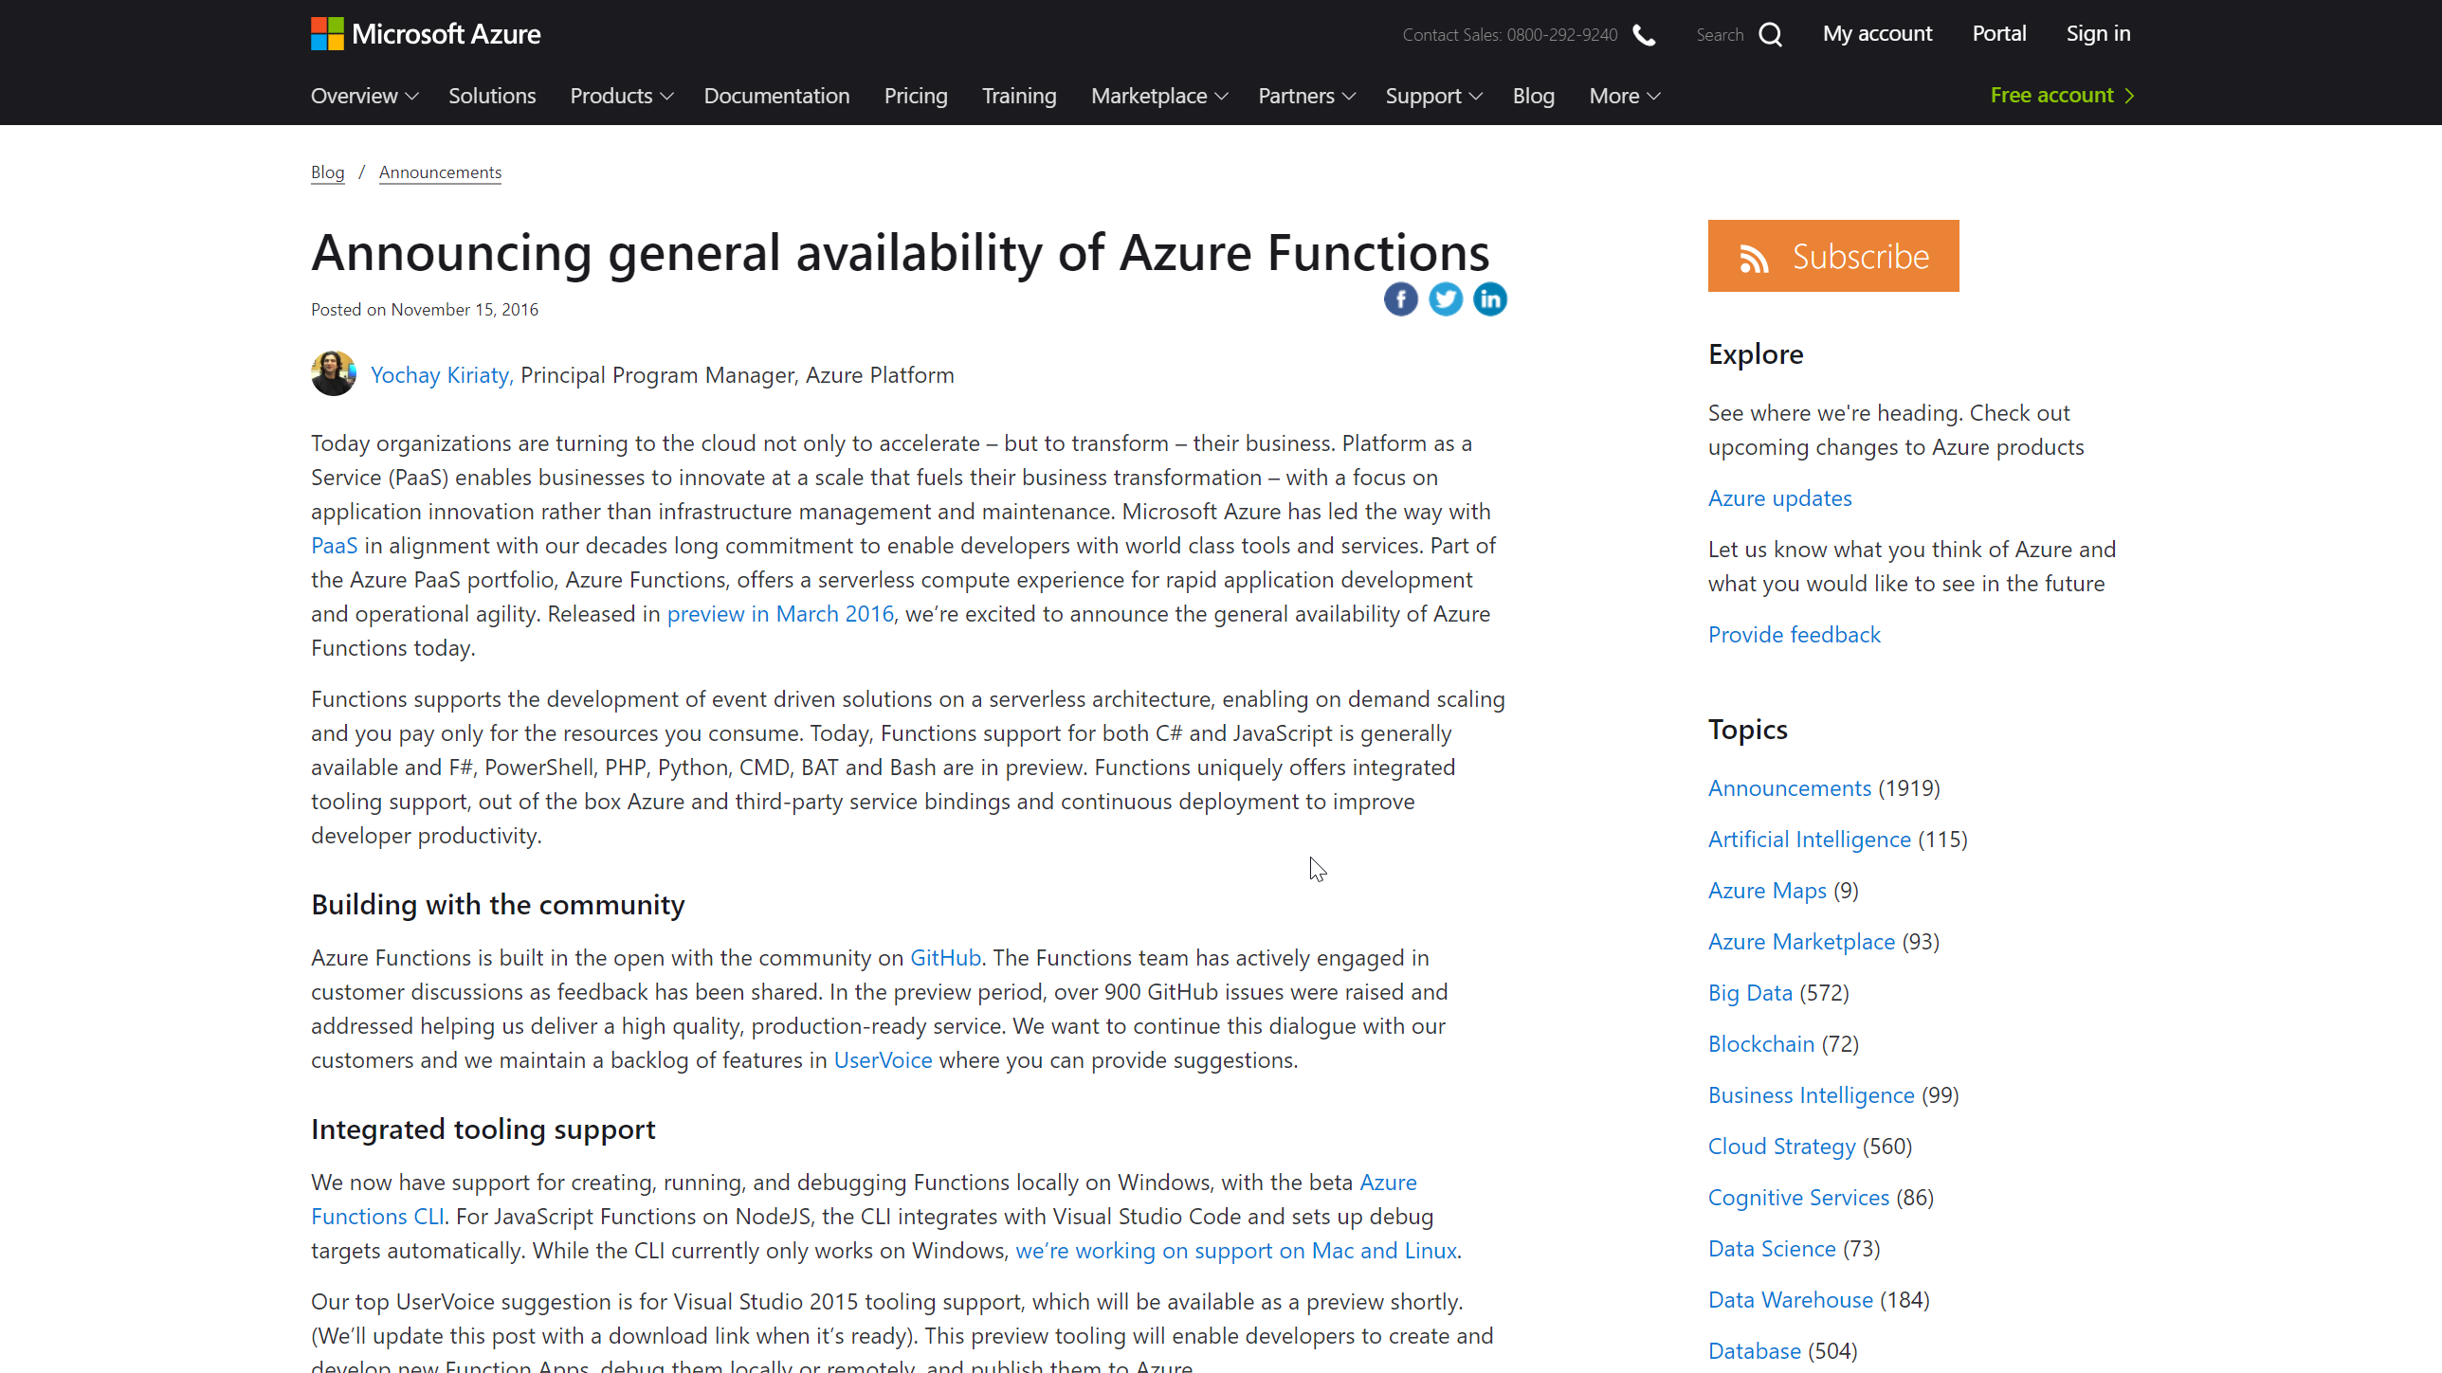
2014 > 2016 > 2017 > 2018
Notes:
Open Source
Multi language

Slide 8
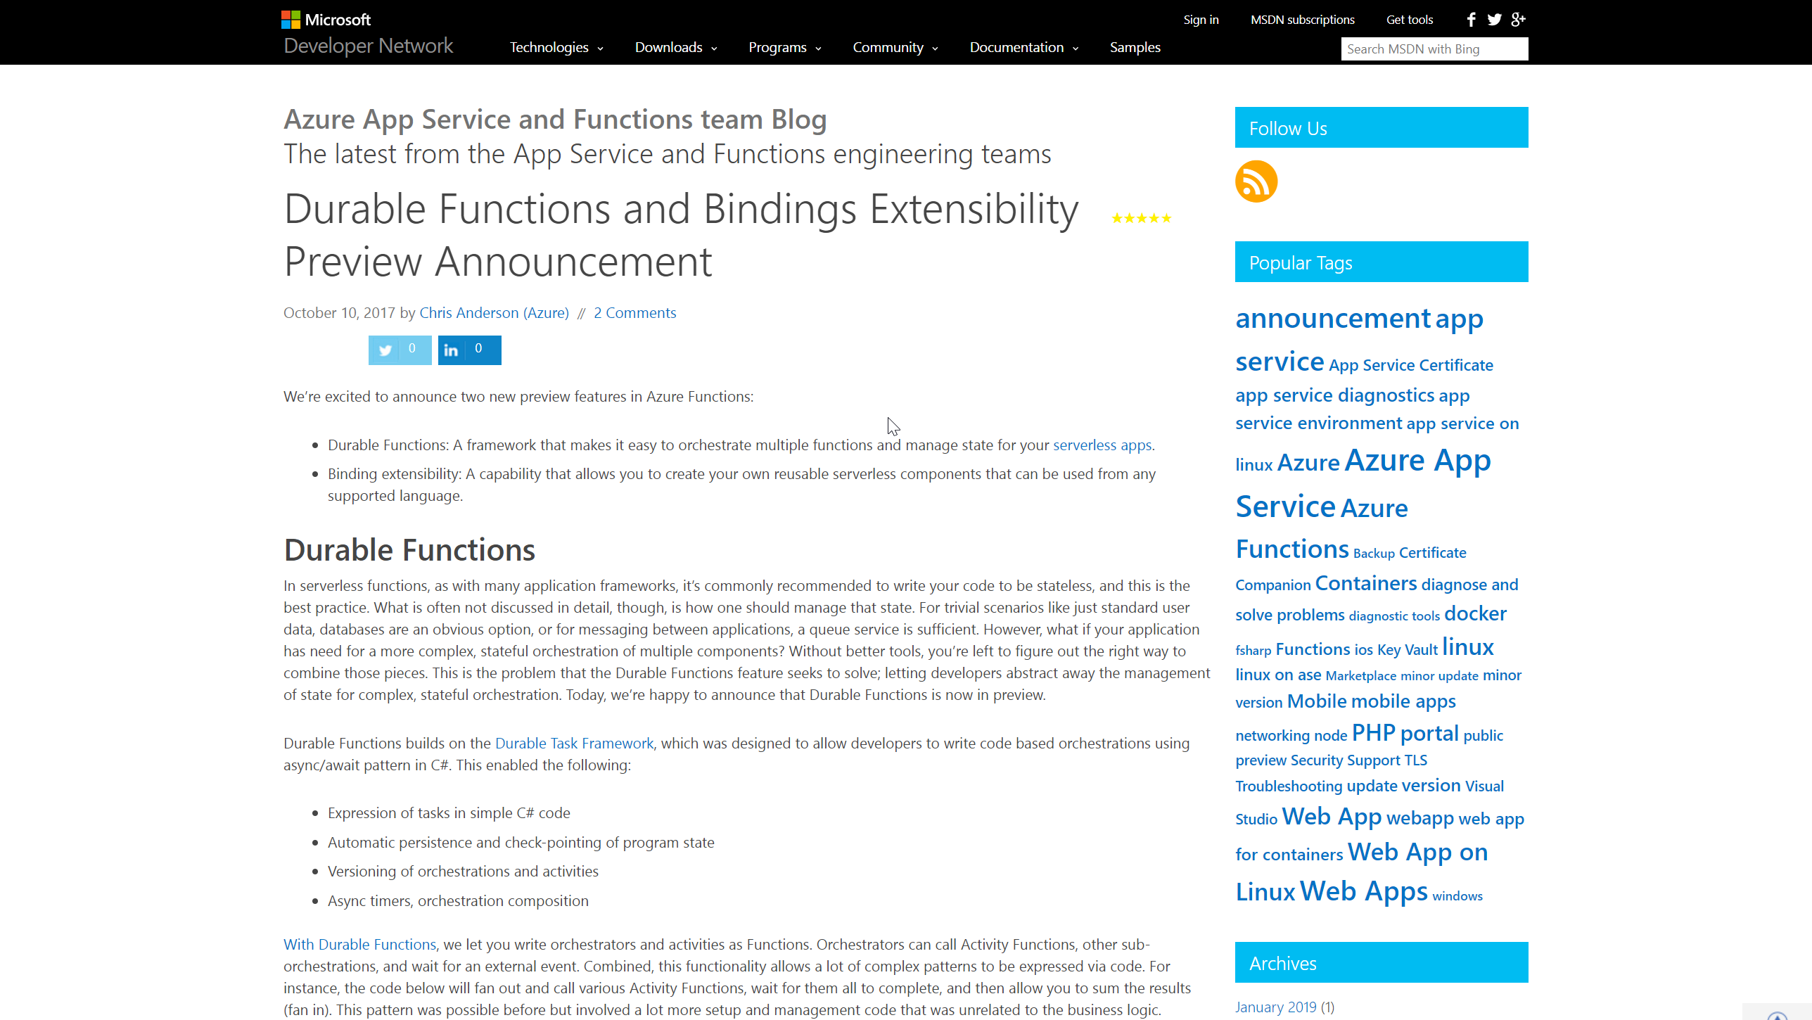
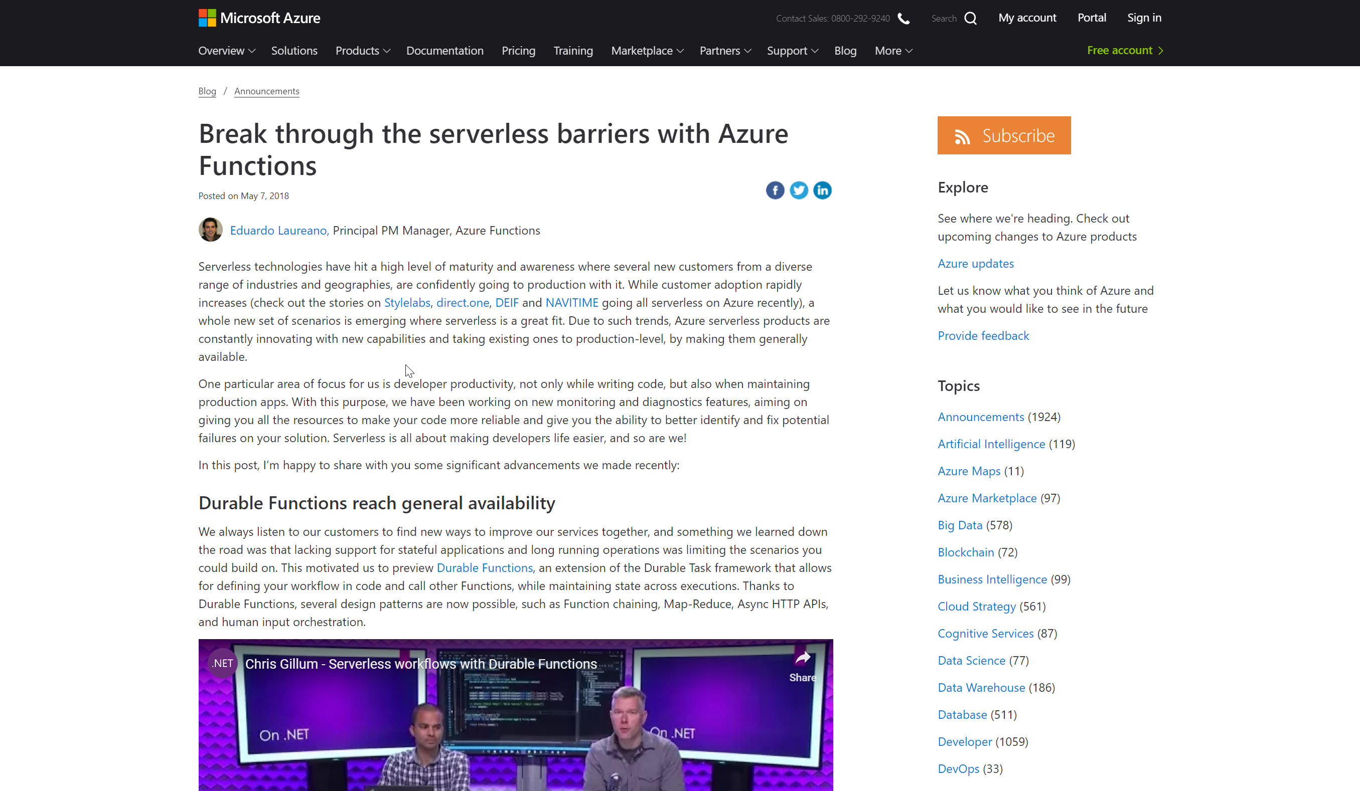
2014 > 2016 > 2017 > 2018
Notes:
Functions Binding extensibility
GA May 7

Slide 9
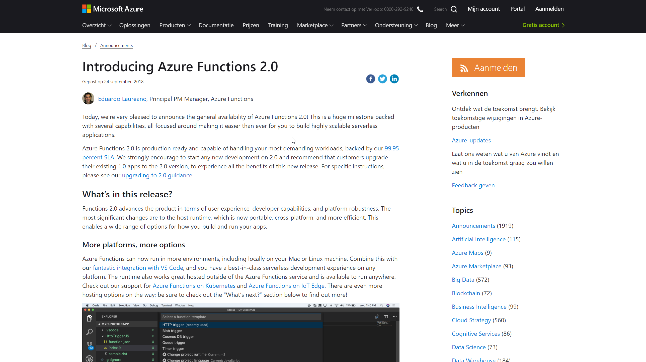
2014 > 2016 > 2017 > 2018

Slide 10
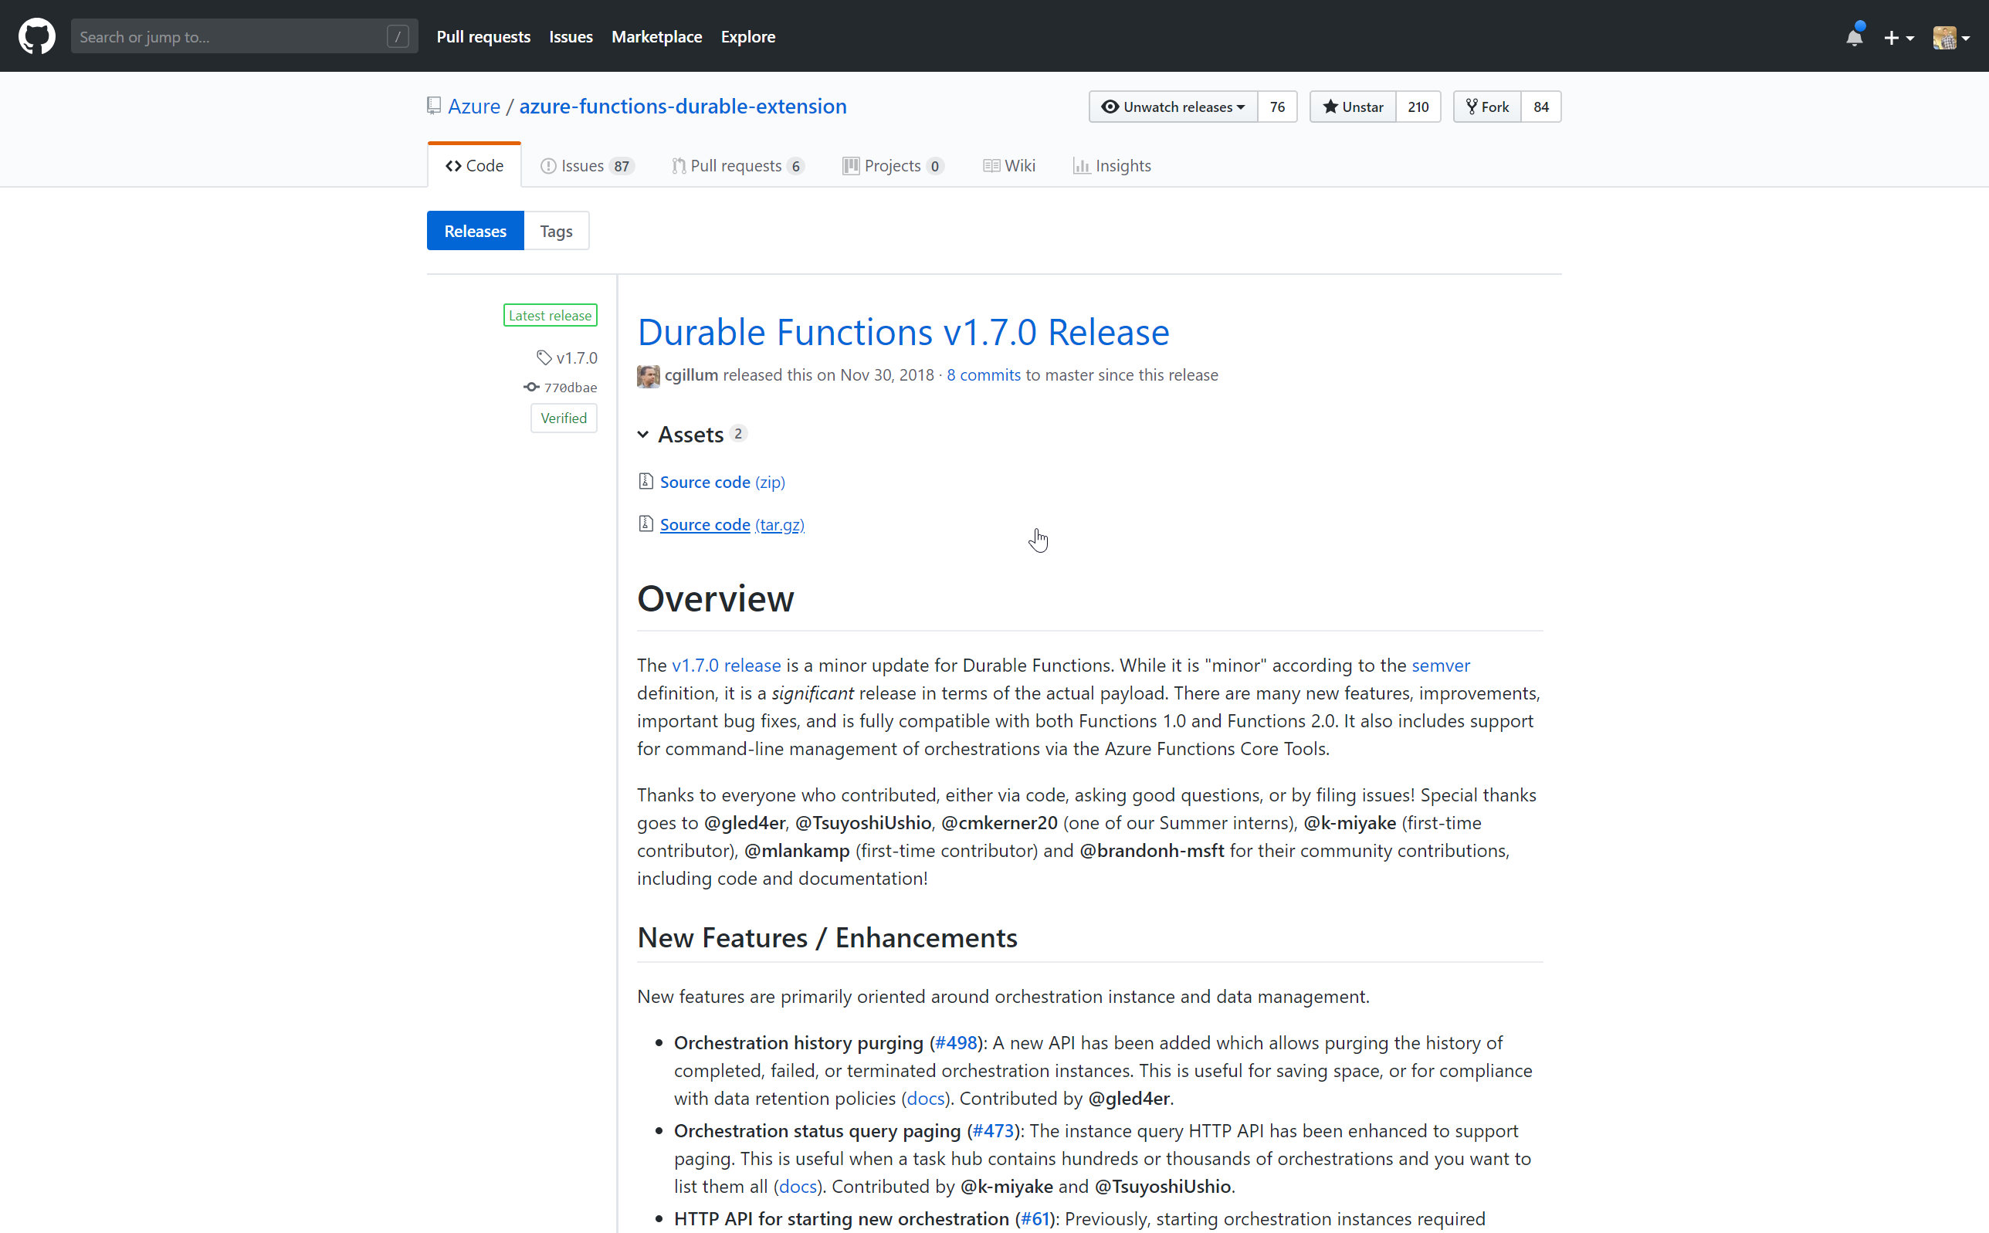
2014 > 2016 > 2017 > 2018

Slide 11


Slide 12
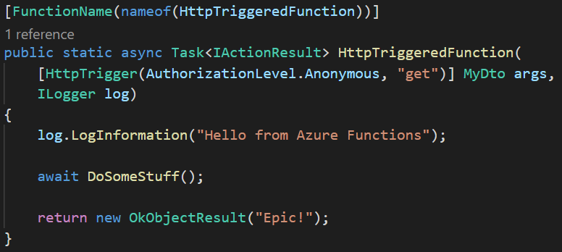
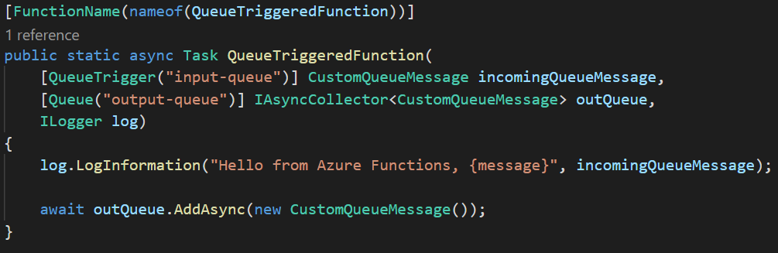
TheLooksOfAFunction()
Notes:
Opiniated model:
- Event Driven
- Short Lived
- Stateless
Problems:
- Sequencing
- Error handling
- Parallel stuff

Slide 13
Activities & Orchestrators
Activities
Do the hard work
Behave like normal functions
Orchestrator
Needs a client
Replays
Deterministic (Datime, Guid, loops, etc.)
Durable (managed state)
Notes:
Activities
Orchestrators
Needs a client /trigger / queue / http
Replays
Deterministic: datetime, guid, while(true)
Durable

Slide 14
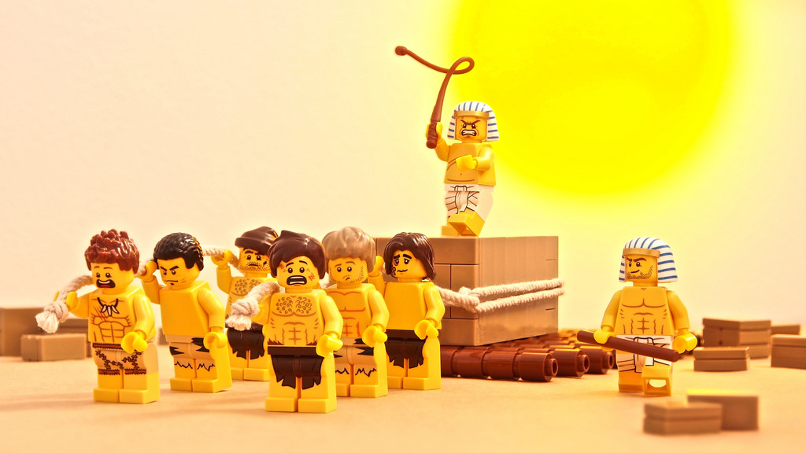

[OrchestrationTrigger]
[ActivityTrigger]
[ActivityTrigger]
[ActivityTrigger]
[ActivityTrigger]
[ActivityTrigger]

Slide 15
Example scenario
New Employee
Create In database
Send welcome mail
Get quote for leasecar
Get quote for leasecar
Get quote for leasecar
Get approval for quote
Ask for feedback

Slide 16
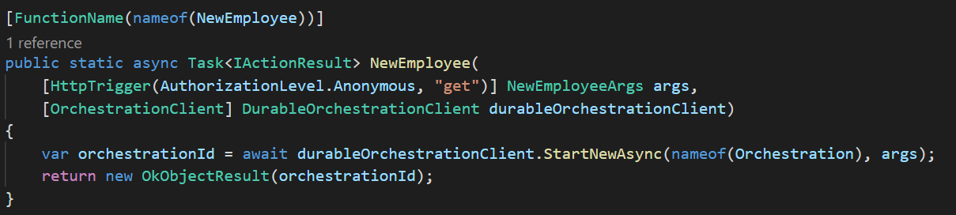
Durable: The core
Activity
Trigger
Result
Input
“Result”
Azure Functions
Start Orchestrator
await DoActivity()
“Result”
Completed
Function
Orchestrator

Slide 17
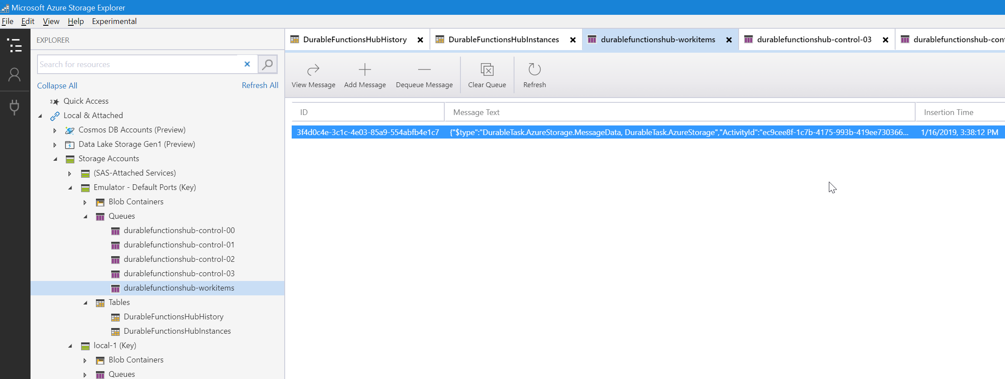
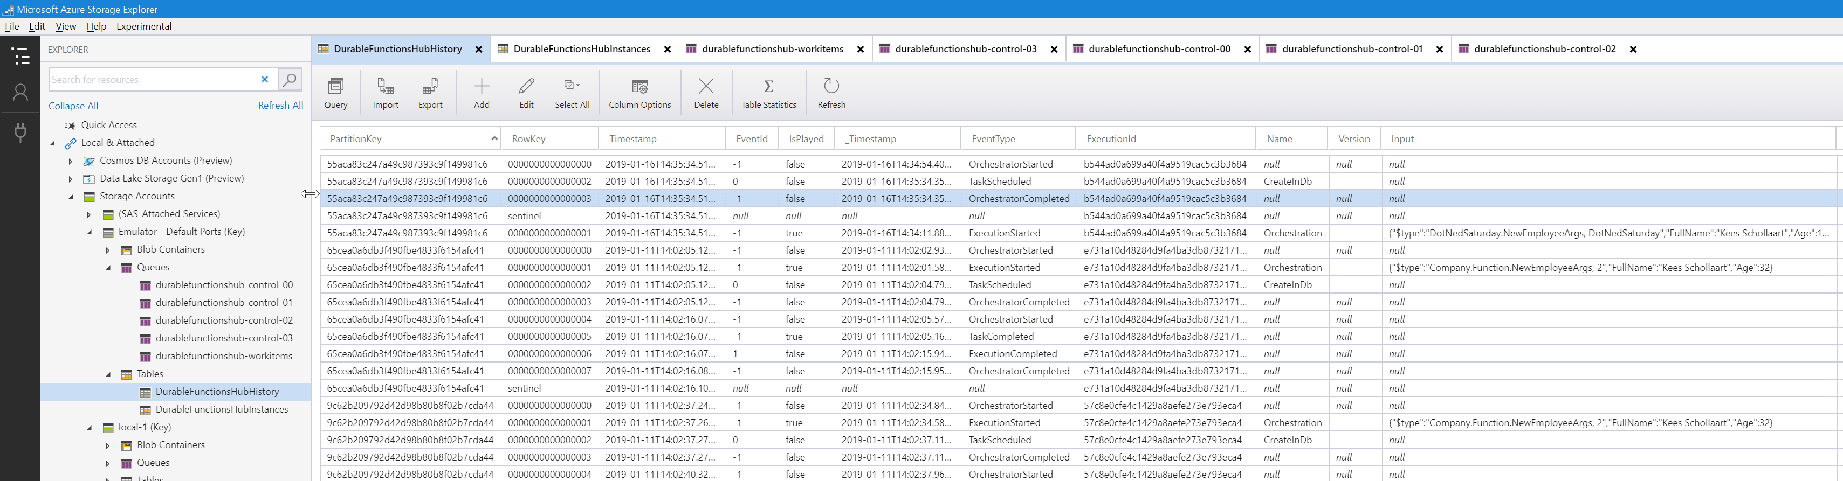

Slide 18
The 5 patterns
Chaining
Fan-out/fan-in
Async HTTP APIs
Monitoring
Human interaction

Slide 19
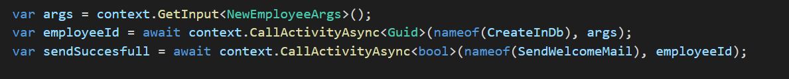
Durable: Chaining
CreateInDb()
SendWelcomeMail()
{ “name”: “John”, “age”: 12 }
HTTP
200 OK
“{employeeId}”
“{employeeId}”
“SendSuccesfull”
Azure Functions
await CreateInDb ()
“{employeeId}”
Start Orchestrator
{ “name”: “John”, “age”: 12 }
await SendWelcomeMail ()
“SendSuccesfull”
Completed
Function
Orchestrator
Notes:
Difficult normale functions (queue? Http?)
Output to Input

Slide 20
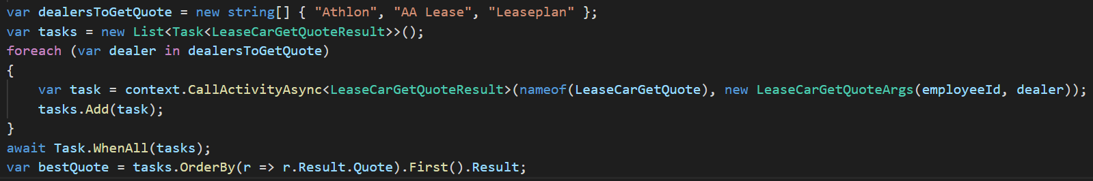
Durable: Fan-out/Fan-in
LeaseCarGetQuote()
{ “employeeId”: “1”, “dealer”: “Leaseplan” }
LeaseCarGetQuote()
HTTP
200 OK
{ “employeeId”: “1”, “dealer”: “Athlon” }
{quote1}
{quote2}
Azure Functions
await Task.WhenAll(tasks)
[ {quote1}, {quote2} ]
Start Orchestrator
Completed
Function
Orchestrator
Notes:
Order > Orderline
Aggregations

Slide 21
Durable: Async API’s
{ "runtimeStatus":“Completed", "lastUpdatedTime":"2017-03-16T21:20:47Z",
"customStatus": { "nextActions": ["A", "B", "C"], "foo": 2 },
“output”: {
“MyProp”: { }
} ...
}
{ "runtimeStatus":"Running", "lastUpdatedTime":"2017-03-16T21:20:47Z",
“customStatus”: {
“MyProp” : “MyValue”
} ...
}
HTTP
200 OK
HTTP: GetStatus
HTTP: GetStatus
Azure Functions
Start Orchestrator
SetCustomStatus(x)
Completed
Function
Orchestrator
await DoStuff()
Activity
Notes:
Blob processing
External service (rate limit)
Async / queue / non-async
Concurrency Throttles > maxConcurrentActivityFunctions

Slide 22
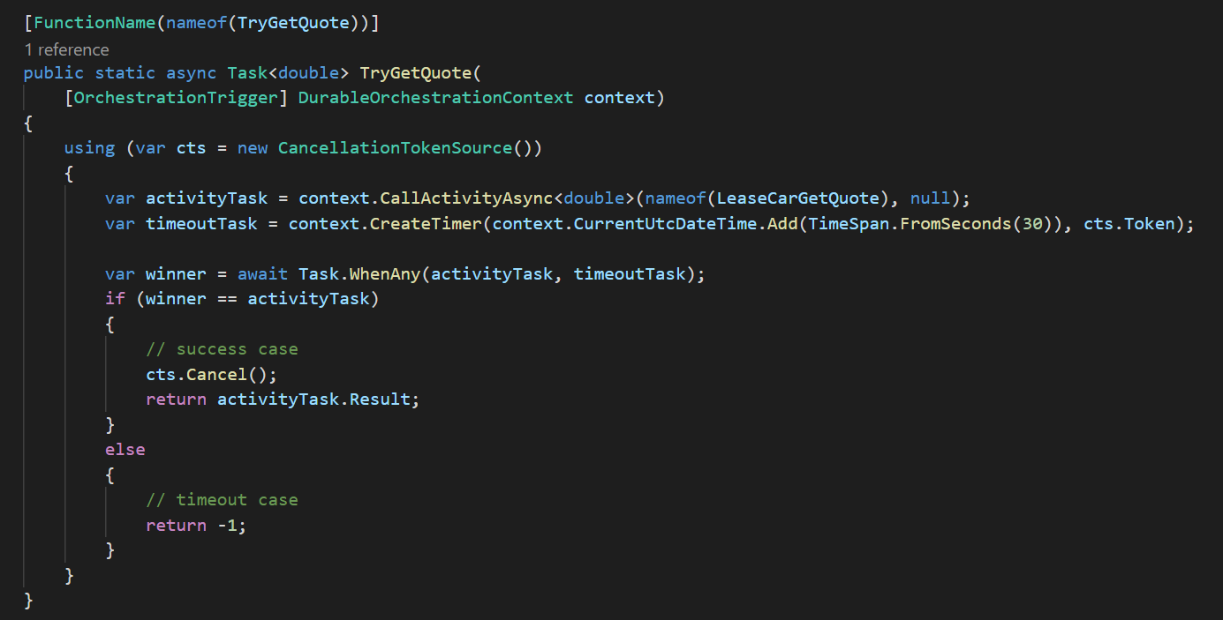
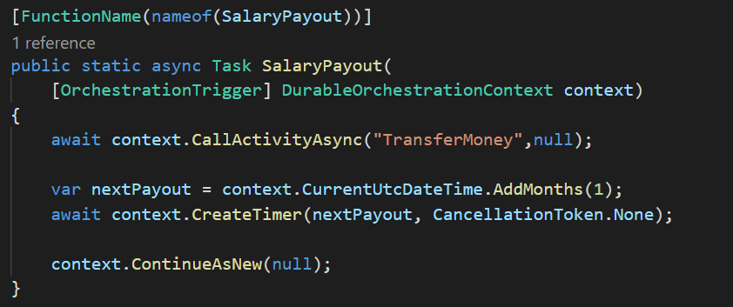
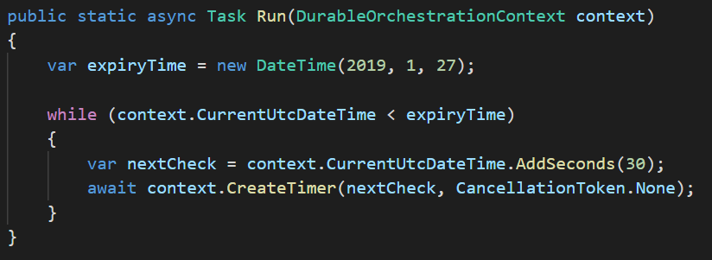
Durable: Monitoring
HTTP
200 OK
Azure Functions
Start Orchestrator
await context.CreateTimer (whenToReturn)
Function
Orchestrator
while(expr)
Notes:
High score
Scheduled/buffered mail
Complexer schedules
Timeout

Slide 23
Durable: Human Intervention
HTTP
200 OK
200 OK
HTTP: RaiseEvent
{ args }
Azure Functions
Start Orchestrator
await WaitForExternalEvent (eventName)
{ args }
Completed
Function
Orchestrator

Slide 24
Demo

Slide 25
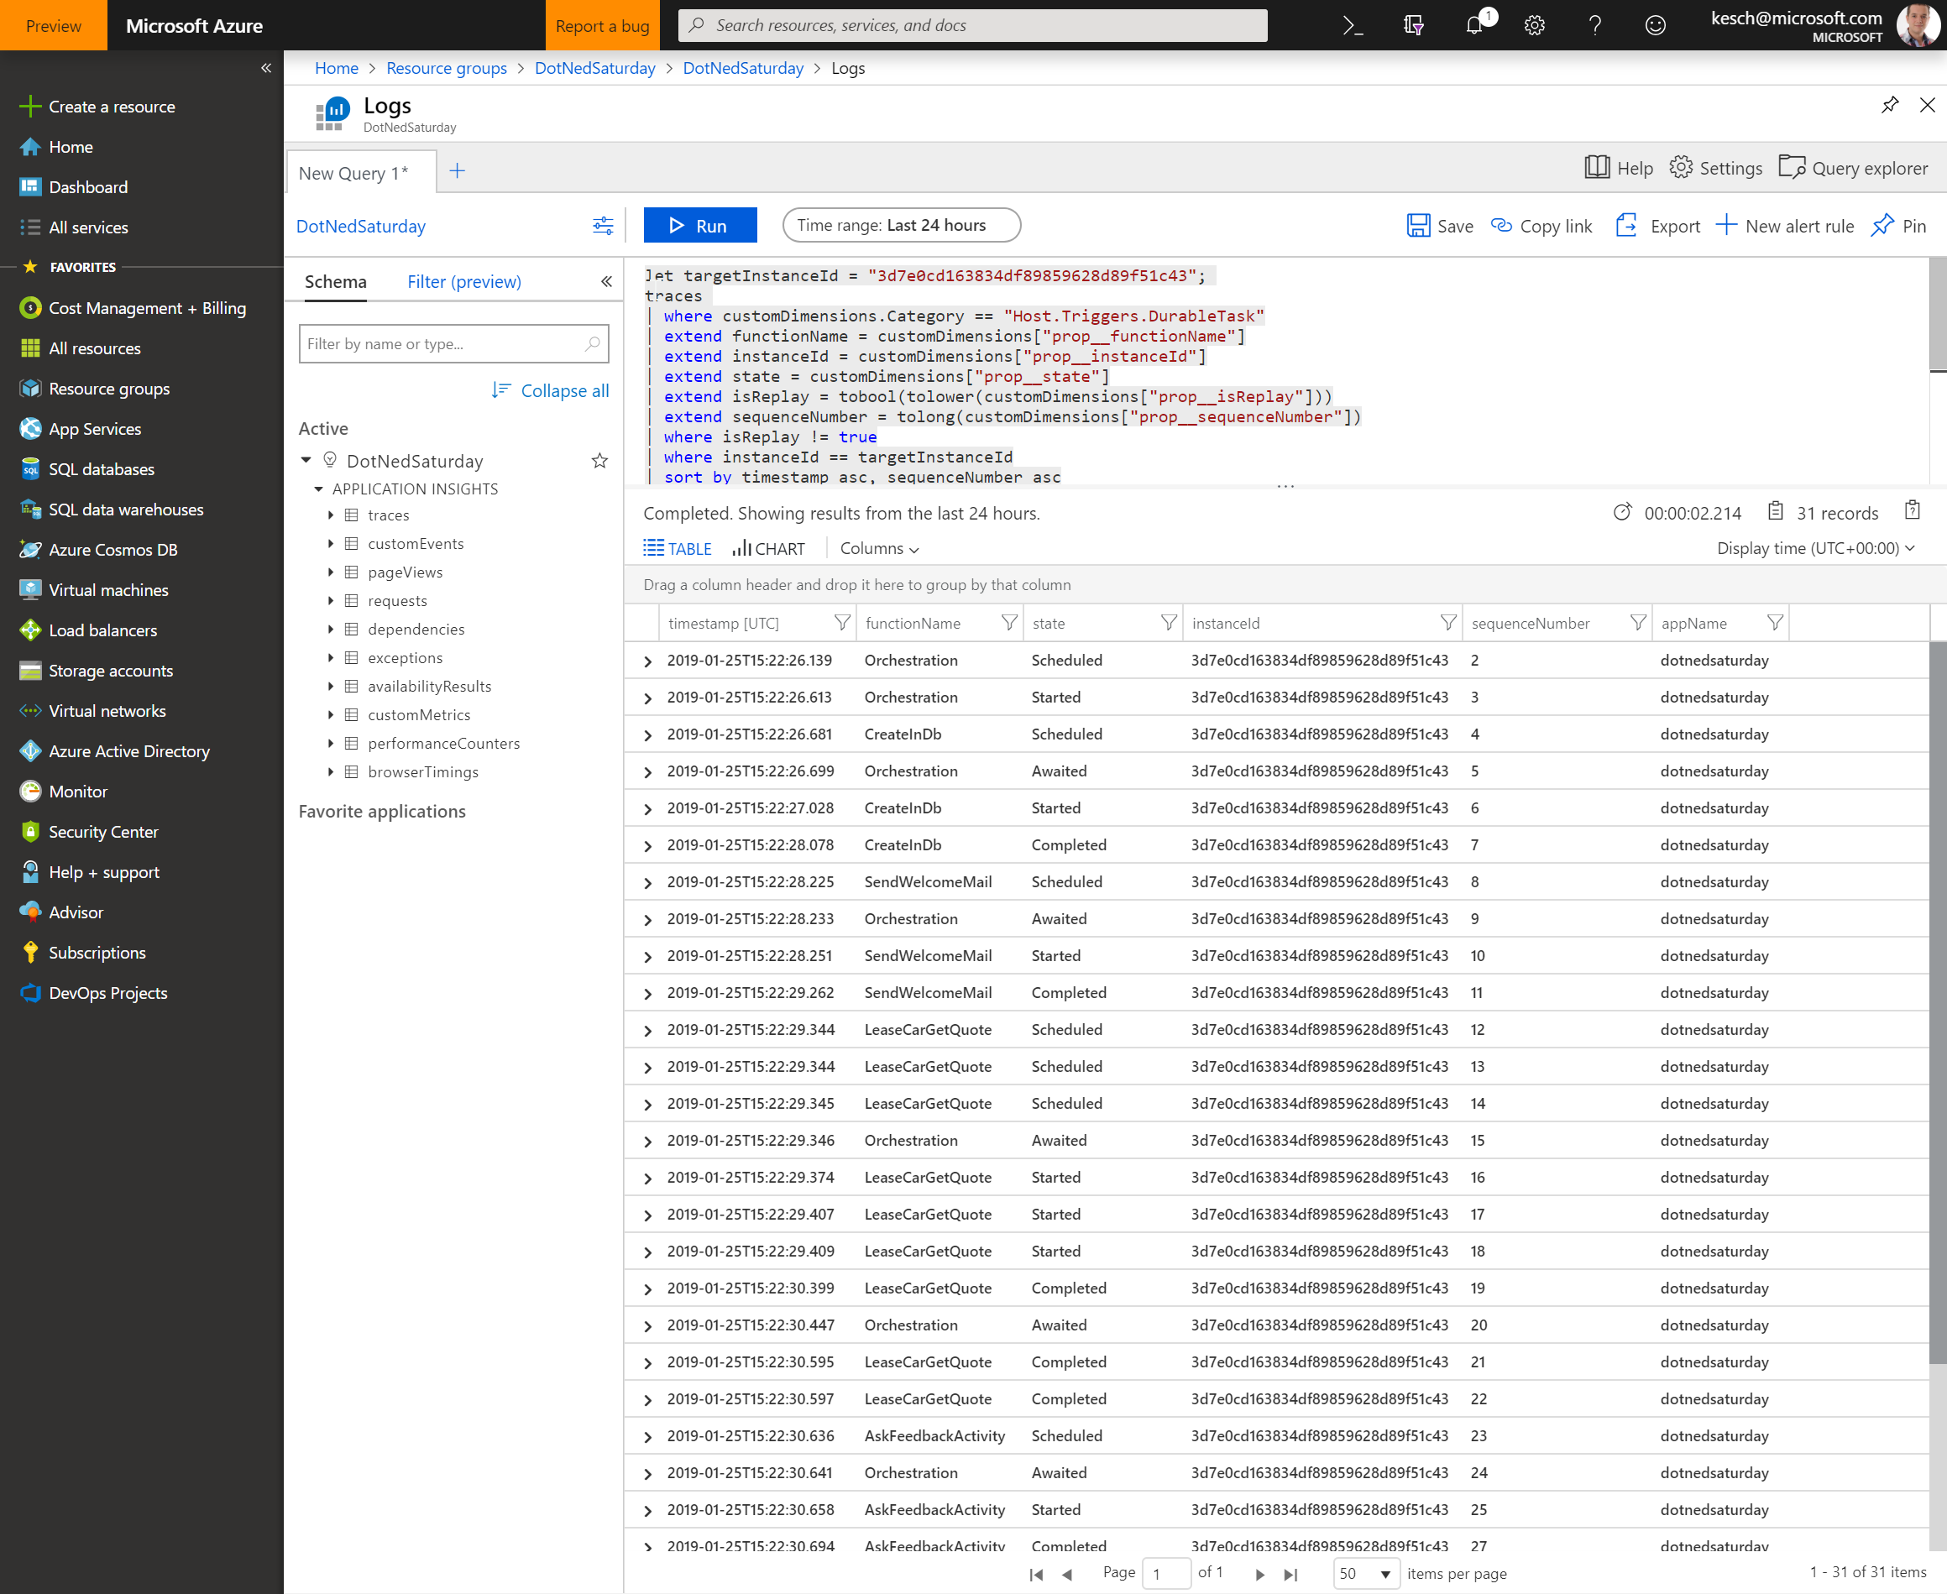
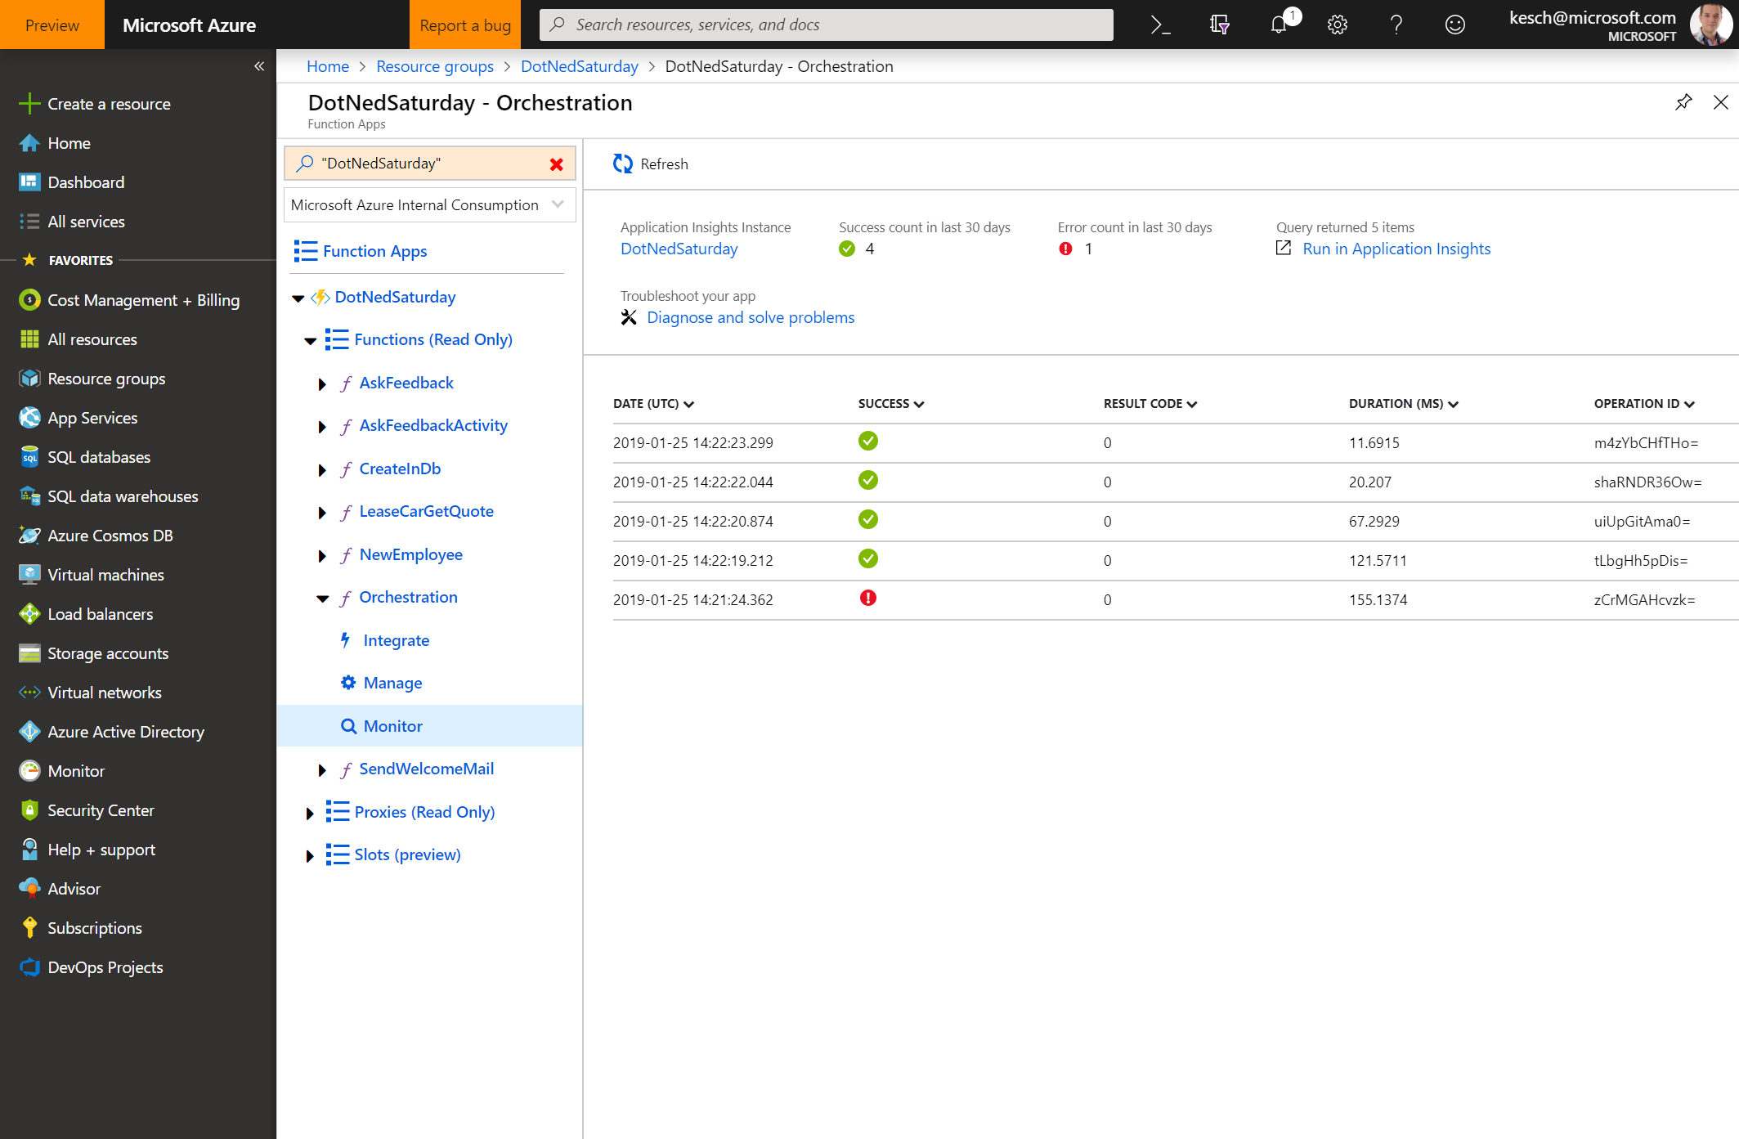
Other stuff
SubOrchestrators
Deployment & versioning
Testing
Monitoring
Notes:
SubOrchestrators > stages, parallel, reuse
Versioning:
- Do nothing
- Stop all in-flight instances (clear control & workitem queues)
- Side-by-side deployments (rename task hub)

Slide 26
Azure Durable Functions make managing state and (complex) workflows easy
Notes:
Developer Friendly > State via Code > Durable/reliable
Distributed operations > long running > Business logic

Slide 27
